Slide 1
Computer Graphics
11th Recitation
“OpenGL: Lighting”
Michael Litvin
Based on slides by Chen Goldberg
10.1.2016
Notes:
The lesson went well. Ex5 took about 30 min, lighting 40 min and the rest was devoted to go through the code together.
Talk about GL_SHININESS

Slide 2
Today!
OpenGL lighting

Slide 3
Lighting
No more glColor

Slide 4
Graphical Pipeline
3D Geometric Primitives
Modeling
Transformation
We Are Here
Lighting
Viewing
Transformation
Projection
Transformation
Clipping
Scan
Conversion
Frame Buffer

Slide 5

No Lights

Slide 6
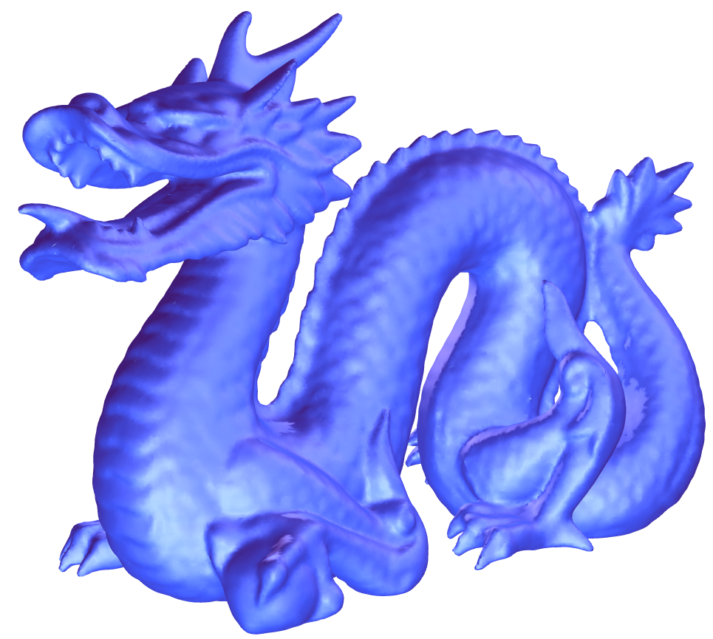
Lights

Slide 7
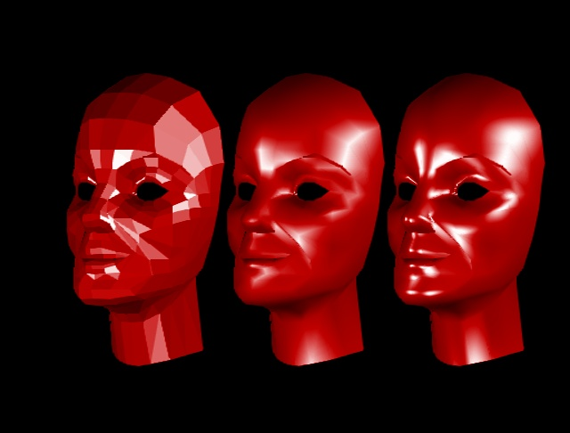
Shading: Flat, Gouraud, Phong
Notes:
Openg-1.ppt
http://www.cs.cmu.edu/~ph/nyit/facet_gouraud_phong.jpeg

Slide 8
OpenGL Lighting Model
Calculates color for each Vertex using Gouraud shading
  Ambient, Diffuse, Specular & Emission
  Replaces glColor(…)
For the lighting model we have to define:
  Normal for each vertex
  Material for each primitive
  Properties for each light source
  Turn on the lights + additional parameters (global)

Slide 9

Step1: Normals
Define normal vectors for each vertex of all the objects.
Call glNormal*() before glVertex*().

Slide 10
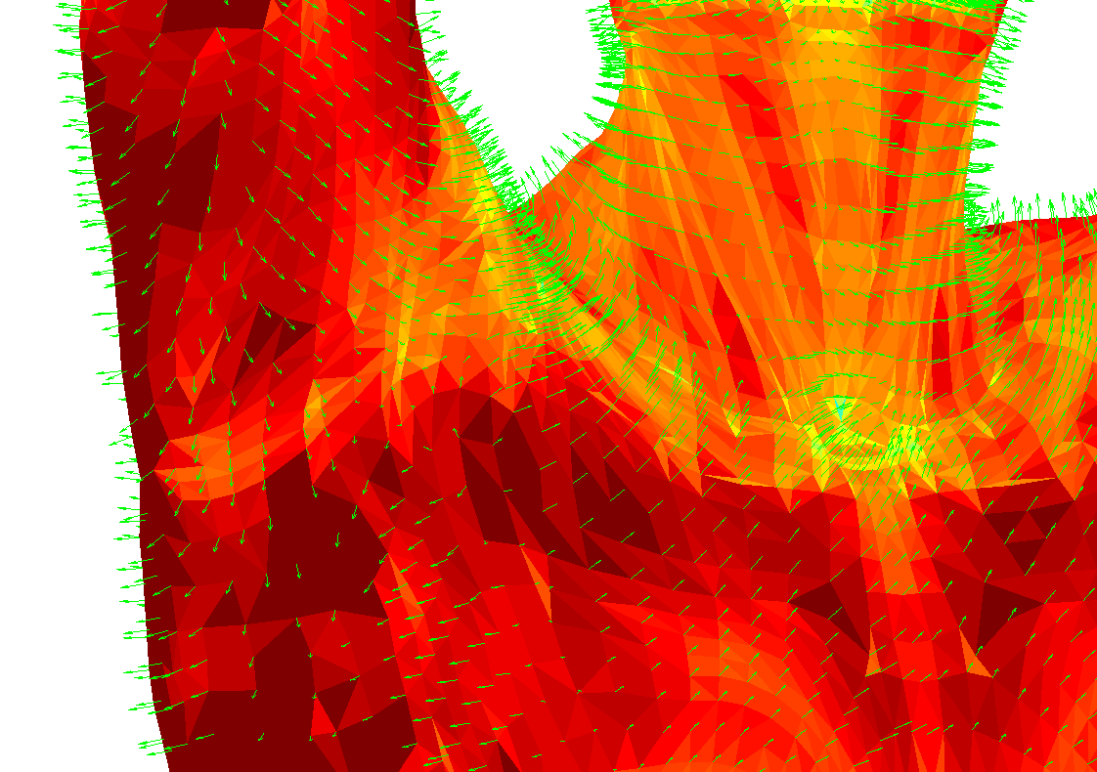
Example
gl.glBegin(GL.GL_QUADS);
gl.glNormal3d(0, 1, 0);
gl.glVertex3d(0, 0, 0);
gl.glVertex3d(0, 0, 1);
gl.glVertex3d(1, 0, 1);
gl.glVertex3d(1, 0, 0);
gl.glEnd();

Slide 11
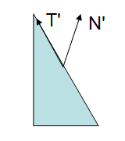
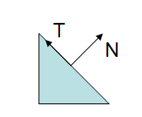
Normalized Normals
For lighting calculation to go right, normals must be normalized.
OpenGL can automatically take care of it
  glEnable(GL_NORMALIZE)
  This is a costly feature but useful because – see next slide.
Transformations affect normals!
  Even if you supply a normalized normal
  Model-view scaling can make it non-normalized!
  OpenGL doesn’t apply Model-view directly! It applies the inverse-transposed matrix (goo.gl/C3QW8)

Slide 12
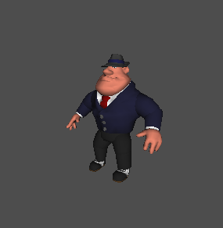
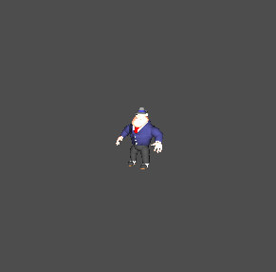
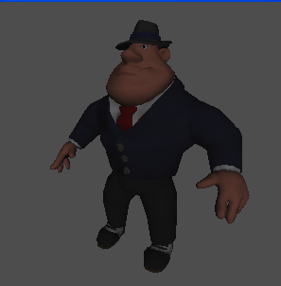
Without GL_NORMALIZE
Original size
glScalef(.3,.3,.3);
glScalef(3,3,3);
Notes:
OpenGL-1.ppt

Slide 13
Step2: Materials
void glMaterial*(face, pname, param);
Specifies a current material property for use in lighting calculations.
Face can be GL_FRONT, GL_BACK, or GL_FRONT_AND_BACK to indicate which face of the object the material should be applied to.

Slide 14
Materials
Pname can be
  GL_AMBIENT
  GL_DIFFUSE
  GL_SPECULAR
  GL_EMISSION
  GL_AMBIENT_AND_DIFFUSE
  GL_SHININESS
Example
    float v[] = {1.0f, 0.0f, 0.0f, 1.0f};
    gl.glMaterialfv(GL.GL_FRONT_AND_BACK,
    GL.GL_DIFFUSE, v, 0);

Slide 15

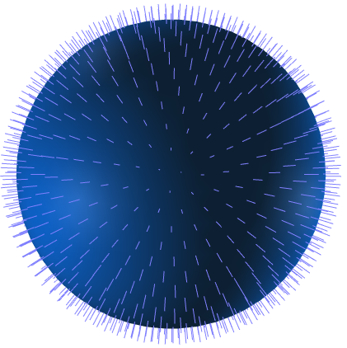
Step3: Lights
Create, select, and position one or more light sources.

Slide 16
Defining Lights
void glLight*(light, pname, param);
Addresses light specified by light, which can be GL_LIGHT0, ... , or GL_LIGHT7
The characteristic of the light being set is defined by pname, which specifies a named parameter
param indicates the values to which the pname characteristic is set.

Slide 17
Defining Lights
pname can get one of several values:
GL_AMBIENT, GL_DIFFUSE & GL_SPECULAR define the light RGBA values for each of the light components.
gl.glLightfv(GL.GL_LIGHT1,
GL.GL_DIFFUSE, new float[] {1f,1f,1f,1f}, 0);
gl.glLightfv(GL.GL_LIGHT1,
GL.GL_AMBIENT, new float[] {0f,0f,0f,0f}, 0);

Slide 18
Directional and Positional Lights
Directional light source is positioned at infinity (like the sun).
Positional light source is positioned near the scene and its exact position determines its effect.

Slide 19
Positioning Lights
when GL_POSITION is passed as an argument to glLight*() four values (x,y,z,w) are passed as parameters.
W determines the type of light we are defining:
0 ⬄ directional - (x,y,z) is the direction.
1 ⬄ positional - (x,y,z) is the position.
(x,y,z,w) can be viewed as homogeneous coordinates
gl.glLightfv(GL.GL_LIGHT1,
GL.GL_POSITION, new float[] {0f,10f,0f,0f}, 0);

Slide 20
Lighting Position
Relative to GL_MODELVIEW
How to simulate a flashlight?
paintEvent()
{
glMatrixMode(GL_MODELVIEW)
glLoadIdentity()
gluLookAt(…)
glLight(GL_POSITION,0,0,1,1)
glRotate(model_rotation)
renderModel()
}
paintEvent()
{
glMatrixMode(GL_MODELVIEW)
glLoadIdentity()
gluLookAt(…)
glRotate(model_rotation)
glLight(GL_POSITION,0,0,1,1)
renderModel()
}
Notes:
אור נשאר עם מודל (ימין) או אור נשאר קבוע ביחס לעולם (שמאל)
לפני המצלמה

Slide 21
Defining Lights: Specular step-by-step
To define specular lighting, define light source:
gl.glEnable(GL.GL_LIGHTING);
gl.glEnable(GL.GL_LIGHT0);
gl.glLightfv(GL.GL_LIGHT0,
GL.GL_SPECULAR,
new float[] {1f,1f,0f,0f}, 0);
gl.glLightfv(GL.GL_LIGHT0,
GL.GL_POSITION,
new float[] {0.5f,1f,1f,0f}, 0);
And material:
gl.glMaterialfv(GL.GL_FRONT_AND_BACK, GL.GL_SPECULAR,
new float[] {1f,1f,1f,1f} , 0);
gl.glMaterialf(GL.GL_FRONT_AND_BACK,
GL.GL_SHININESS, 10f);

Slide 22

Additional Options
GL_CONSTANT_ATTENUATION, GL_LINEAR_ATTENUATION, GL_QUADRATIC_ATTENUATION.
These define the attenuation of the light. Usually disabled for directional lights.
GL_SPOT_DIRECTION, GL_SPOT_EXPONENT,
GL_SPOT_CUTOFF.
These define spotlights and spotlight properties.
exponent
cutoff

Slide 23
Example
gl.glLightfv(GL.GL_LIGHT1, GL.GL_POSITION, new float[] {0,0,0,1}, 0);
gl.glLightf(GL.GL_LIGHT1,
GL.GL_SPOT_CUTOFF, 10);
gl.glLightf(GL.GL_LIGHT1,
GL.GL_SPOT_EXPONENT, 100f);
gl.glLightf(GL.GL_LIGHT1,
GL.GL_QUADRATIC_ATTENUATION, 0.5f);
Notes:
TODO: GL_SPOT_POSTION

Slide 24
Multiple Light Sources
You can define several light sources by calling glLight*() several times with different light names:
glLightfv(GL_LIGHT0, GL_AMBIENT, light0_ambient);
glLightfv(GL_LIGHT1, GL_AMBIENT, light1_ambient);

Slide 25
Let There Be Light
Turning on the lighting model:
  glEnable(GL_LIGHTING);
  This makes OpenGL ignore glColor and instead take vertex color from lighting model
Turning on light sources
  glEnable(GL_LIGHT#);
Remember – Each extra light require significant computation time

Slide 26
OpenGL Lighting Model

Slide 27
Lighting Model Attributes
void glLightModel*(pname, param);
GL_LIGHT_MODEL_AMBIENT
  defines the global ambient RGBA values.
  Default: (0.2, 0.2, 0.2, 1.0)
GL_LIGHT_MODEL_TWO_SIDE
  determines whether we are using two sided lighting.
  Default: false
  Example:
  gl.glLightModeli(
  GL.GL_LIGHT_MODEL_TWO_SIDE,
  GL.GL_TRUE);

Slide 28
Missed glColor?
void glColorMaterial(face, mode);
Replaces effect of glMaterial with glColor for the specified attributes.
face
  GL_FRONT, GL_BACK, or GL_FRONT_AND_BACK
mode
  GL_EMISSION, GL_AMBIENT, GL_DIFFUSE, GL_SPECULAR, and GL_AMBIENT_AND_DIFFUSE
Has to be enabled
  gl.glEnable(GL.GL_COLOR_MATERIAL);

Slide 29
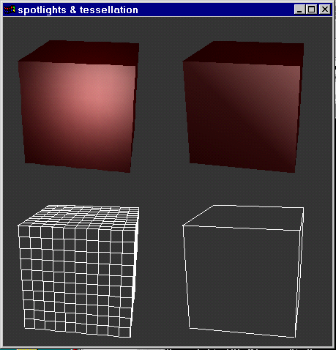
Lighting Limitations

Slide 30
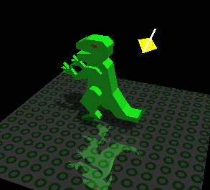
Global Illumination in OpenGL
…Can the lighting model calculate shadows?
The effects of Shadows and Reflection are obtained using various advanced techniques
Not out of the box.

Slide 31
Simple Text
Rendering 2D letters

Slide 32
Simple Text
Set raster position in pixel coordinates
  gl.glWindowPos*(x,y)
Draw text
  GLUT glut = new GLUT();
  glut.glutBitmapString(font, string);
  font could be GLUT_BITMAP_9_BY_15, GLUT_BITMAP_8_BY_13, GLUT_BITMAP_HELVETICA_18, GLUT_BITMAP_HELVETICA_12, GLUT_BITMAP_HELVETICA_10, GLUT_BITMAP_TIMES_ROMAN_24, GLUT_BITMAP_TIMES_ROMAN_10
  openglut.sourceforge.net/group__bitmapfont.html
Not very versatile…
No Hebrew…
Better options exist

Slide 33
Simple Text Troubleshooting
You might want to disable the following while rendering text:
  Lighting
  Depth test
Example
      gl.glDisable(GL.GL_DEPTH_TEST);
      gl.glDisable(GL.GL_LIGHTING);
      gl.glColor3d(1, 0, 0);
      gl.glWindowPos2d(50, 100);
      GLUT glut = new GLUT();
      glut.glutBitmapString(GLUT.BITMAP_HELVETICA_12,
      "My OpenGL text");
      gl.glEnable(GL.GL_LIGHTING);
      gl.glEnable(GL.GL_DEPTH_TEST);

